Slide 1
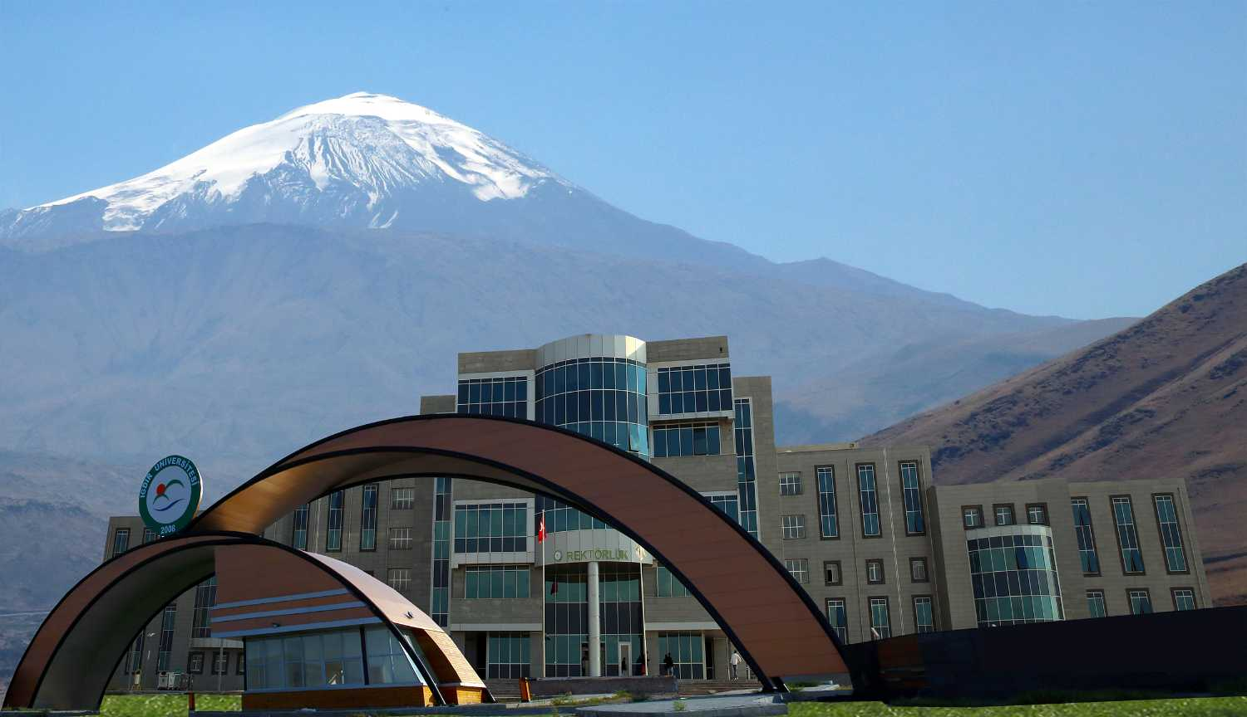
IĞDIR UNIVERSITY
FACULTY OF ENGINEERING
DEPARTMENT OF MECHANICAL ENGINEERING
SUVEREN , IĞDIR , TURKEY
https://muhendislik.igdir.edu.tr/mechanical-engineering

Slide 2
OUTLINE
WHAT IS MECHANICAL ENGINEERING ?
WHY MECHANICAL ENGINEERING ?
EMPLOYMENT AREAS
SOME RESEARCH AREAS OF MECHANICAL ENGINEERING
BEING A MECHANICAL ENGINEER
MECHANICAL ENGINEERING DEPARTMENT OF IĞDIR UNIVERSITY
objectıves
Academic Staff and Sub-Departments
courses taught in this program
APPLIED ENGINEERING EDUCATION
Facilities
Those Who Completed the Program
QUESTIONS

Slide 3
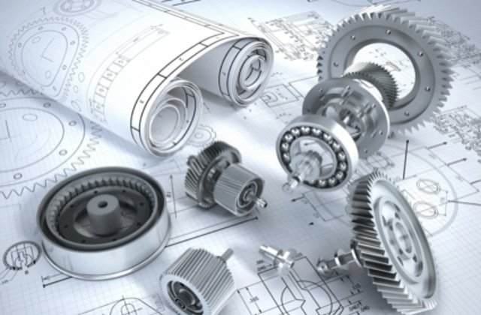
MECHANICAL ENGINEERING
Mechanical Engineering is an engineering branch that makes research and development using the principles of motion, energy and force to carry out the design, production, assembly, analysis and maintenance of all kinds of mechanisms, mechanical systems and energy conversion systems.
Figure 1. Design of Mechanical Systems [1].

Slide 4
WHY MECHANICAL ENGINEERING ?
Mechanical engineering, known as the mother of engineering branches, and it is among the oldest and broadest engineering disciplines.
In today's world, it takes place in every area of modern life, from mobile phones to biomedical devices, from automobile to aviation industry and from machine design to energy systems.
Also, mechanical engineers deal with not only engineering but also economic issues, from the cost of a single component, to the economic impact of a manufacturing plant.
Last but not least, mechanical engineers have the chance to take role in manager positions in their employments areas and many mechanical engineers have opportunity to set up their own business.

Slide 5
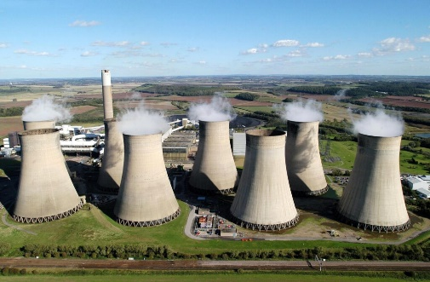
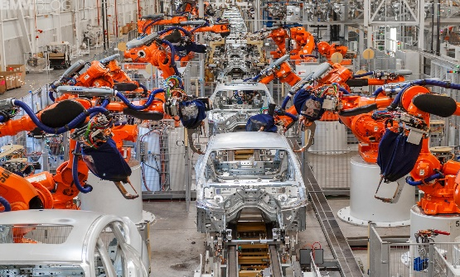
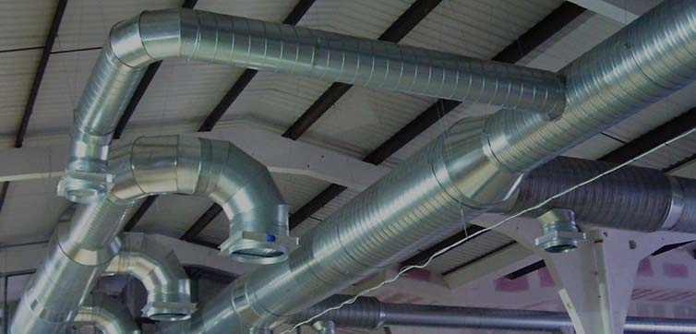
EMPLOYMENT AREAS
Mechatronics
Machine Design Engineering
Engineering design
Energy Engineering
Aerospace Engineering
HVAC Engineering
Computer Integrated Manufacturing
Thermal engineering
Automotive Engineering
Marine Engineering
Production Engineering
Fluid mechanics and thermal science
Robotic and automation
Solid Mechanics and design
Power Plant Engineering
Design of Mechanical Equipment
Figure 2. Coal Fired Power Plant [2].
Figure 5. Automobile Assembly Line [5].
Figure 3. HVAC Systems [3].
Figure 6. Marine Engineering [6].
Figure 4. Aerospace Engineering [4].
Figure 7. Wind and Solar Power [7].

Slide 6
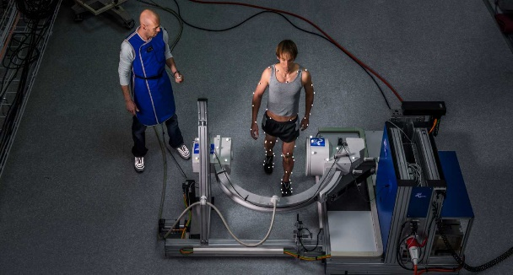
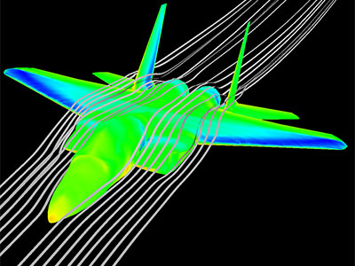
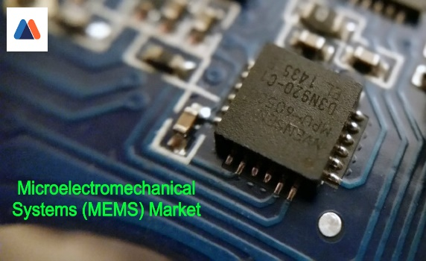
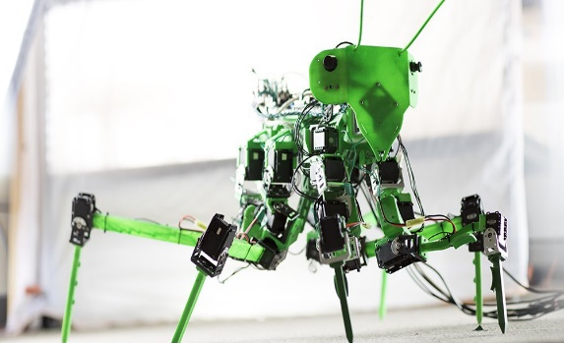
SOME RESEARCH AREAS OF MECHANICAL ENGINEERING
Micro electro-mechanical systems (MEMS)
Composites
Nanotechnology
Mechatronics
Finite element analysis
Biomechanics
Computational fluid dynamics
Acoustical engineering
Figure 8. Computational Biomechanics [8].
Figure 9. Computational Fluid Dynamics (CFD) [9].
Figure 10. Micro-Electro Mechanical
Systems (MEMS) [10].
Figure 11. Small scale and Enormous impact of
NANOTECHNOLOGY [11].
Figure 12. Composite Materials [12].
Figure 13. Robotics and Mechatronics [13].

Slide 7
BEING A MECHANICAL ENGINEER
In order to become a mechanical engineer, dedication, hard work and sincerity are always needed. Therefore, mechanical engineering plays an extremely important role for a complete development of education and personality.
Anyone wishing to work in the field of mechanical engineering should be a well-trained person in numerical reasoning, mathematics, physics and economics.
In order to be a mechanical engineer, the person should develop his / her ability to analyze by gathering information in a meaningful order and to solve problems by making use of it.
In addition, being patient, tolerant, having good communication and having ability to establish good relationships in professional life are the characteristics that mechanical engineers should have.

Slide 8
MECHANICAL ENGINEERING DEPARTMENT
Mechanical Engineering Department was established in 2008 within the body of Engineering Faculty of Iğdır University.
The department received its first students in the 2019-2020 academic year and teaching activities has been carried out by 7 academic staff ; 1 professor, 4 assistant professors, 1 lecturer and 1 research assistant.
Thanks to our fully equipped computer laboratory and department laboratory, our students have the opportunity to design their project and conduct experiments related to their departments to increase their engineering skills and knowledge.

Slide 9
OBJECTIVES
Mechanical Engineering Department has adopted the principle of training reliable, successful, innovative, problem-solving and entrepreneur Mechanical Engineers.

Slide 10
courses taught in this program
In the first year of the program of mechanical engineering, basic courses such as mathematics, physics, chemistry, technical drawing, computer programming and statics are taught.
Deparment courses such as engineering mathematics, thermodynamics, fluid mechanics, dynamics, mechanics of materials and material science are taught in the second year . In addition, with the machine tools course, students will be able to familiar with the machines in the laboratory and use these machines actively.
In the third year, laboratory courses are taught along with courses such as heat transfer, machine design, dynamics of machinery. Thanks to laboratory courses, students have the opportunity to conduct experiments and increase their knowledge.
In the 4th year, students complete the graduation project. Besides, many courses are elective and students will be able to choose from these courses.
Mechanical engineering students take technical elective courses and complete two summer internships to specialize in one of the previously mentioned employment areas.

Slide 11
Academic Staff and Sub-Departments
Department of Machine Theory and Dynamics
Professor Ömer Gündoğdu
(Head of Department )
Department of Mechanics
Assistant Professor Gökçen Akgün
(Head of Department )
Material scıence department
Lecturer Tayfun Sosyal
Department of Energy
Assistant Professor Ferhat Kaya
(Head of Department )
Department of Construction and Manufacturing
Assistant Professor Mustafa Hamamcı
(Head of Department )
Department of Thermodynamics
Assistant Professor Melih Yıldız
(Head of Department )
Res. Assist. Ahmet Aktürk

Slide 12
Those Who Completed the Program
Mechanical engineering is a 4-year degree program. The person who completes this program gets a bachelor's degree and has the title of mechanical engineer.
The person who gained the title of mechanical Engineering starts working and specializes in one of the previously mentioned employment areas..

Slide 13
APPLIED ENGINEERING EDUCATION
In the 8th semester, successful students selected by the department committee will continue their education in a factory or organization predetermined and will have the opportunity to specialize in the desired field.

Slide 14
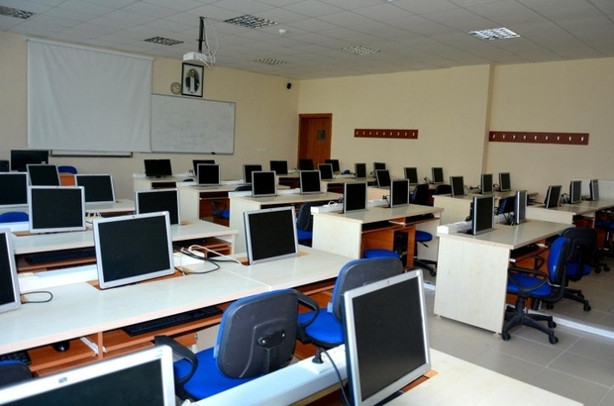
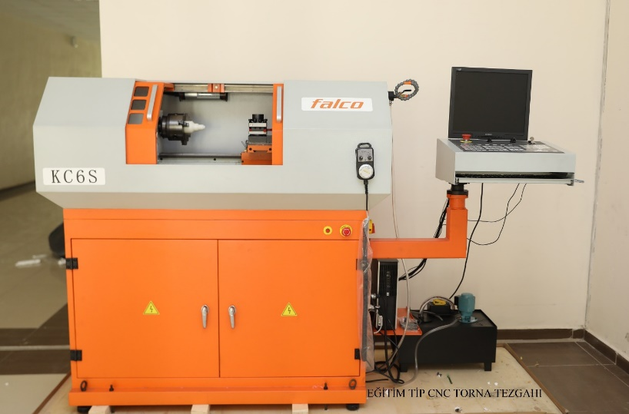
FACILITIES & LABORATORIES
Figure 14. Overview of Computer Laboratory .
Figure 15. CNC Lathe Machine .

Slide 15
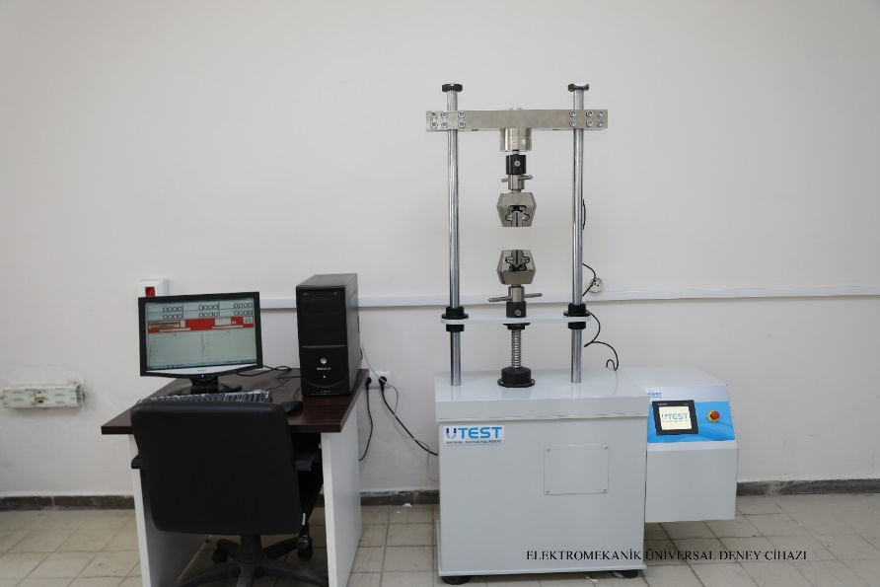
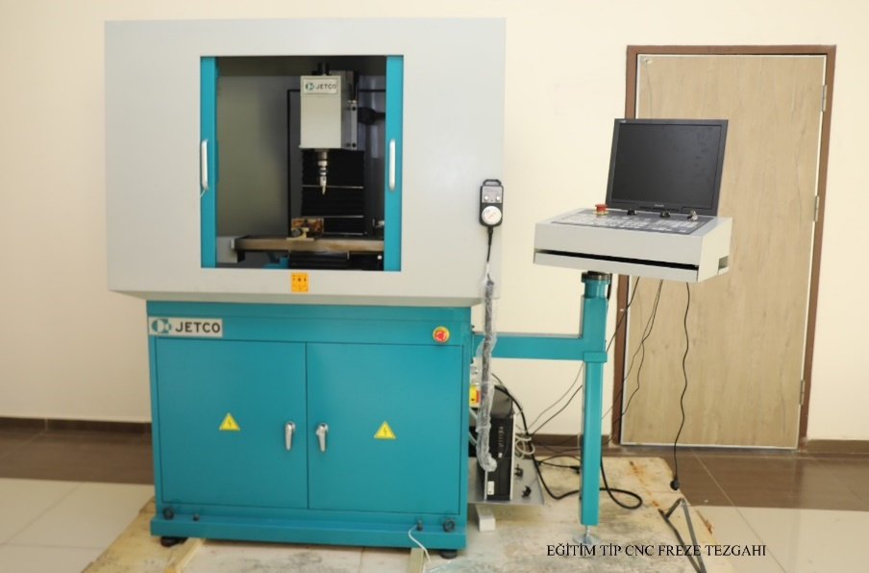
FACILITIES & LABORATORIES
Figure 16. Tensile Testing Machine .
Figure 17. CNC Milling Machine .

Slide 16
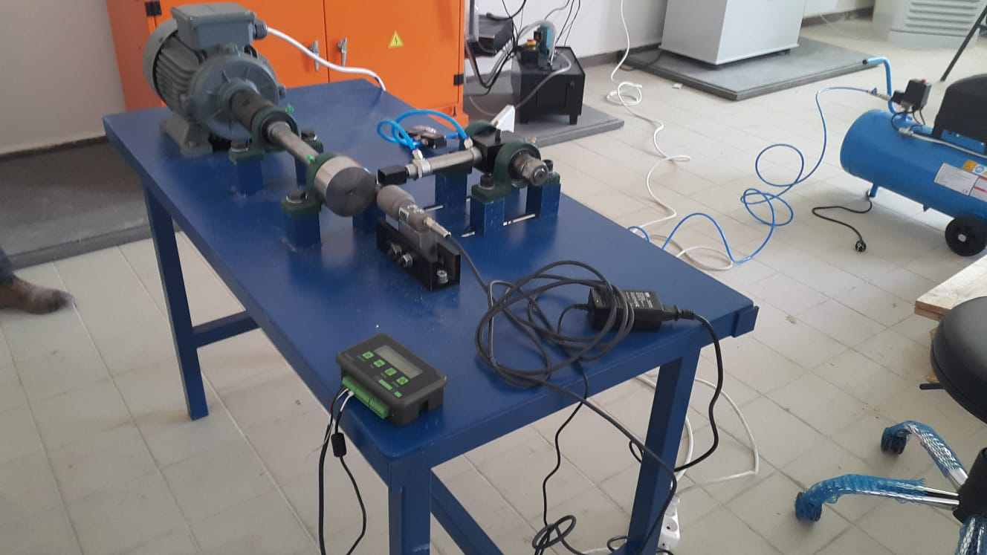
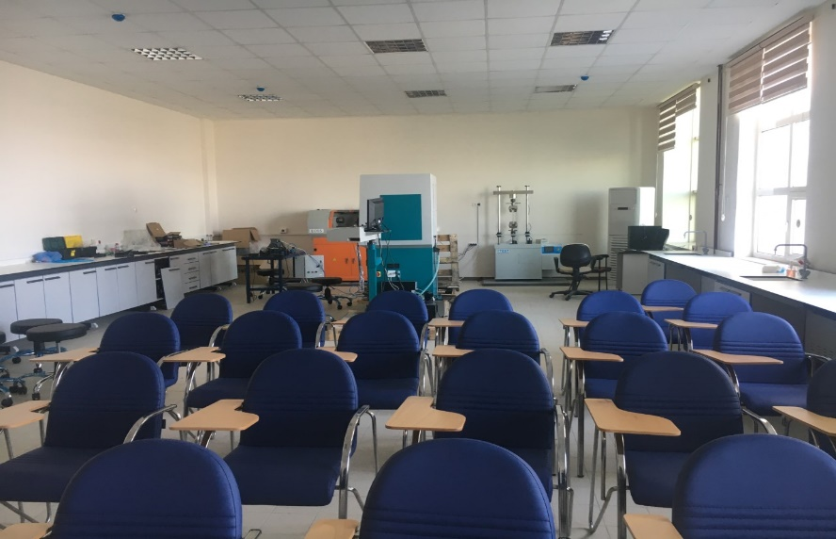
FACILITIES & LABORATORIES
Figure 18. Wear Test Machine .
Figure 19. Overview of department laboratory .

Slide 17
BE PART OF US
Thank you for listening

Slide 18
ANY QUESTİONS ?
ANY QUESTİONS ?
For Contact: aakturk@igdir.edu.tr

Slide 19
REFERENCES
http://bag-making-machines.net/mechanical-engineering-and-why-its-popular-amongst-other-engineering-fields/
https://www.newcivilengineer.com/archive/insight-how-uk-power-plants-are-going-coal-free-11-06-2018/
https://www.actionduct.com/ten-main-reasons-hvac-systems-get-dirty/
https://www.inverse.com/article/62185-here-s-how-you-will-connect-to-starlink-spacex-s-internet-constellation
https://mojix.com/7-ways-rfid-automotive-manufacturing/
http://www.itechgrid.com/ship-engineering/
https://ensia.com/articles/renewable-energy-wind-solar/
https://movement.ethz.ch/
https://www.uab.edu/engineering/me/research/computational-fluid-dynamics
http://reportsurvey.over-blog.com/2019/01/microelectromechanical-systems-mems-market-research-methodology-production-issues-by-2024.html

Slide 20
REFERENCES
https://medium.com/swlh/small-scale-enormous-impacts-the-world-of-nanotechnology-9a2bf19e3c42
https://www.process-heating.com/articles/92888-composite-materials-require-specialized-processing
https://engineering.case.edu/mechanical-and-aerospace-engineering/research/robotics-and-mechatronics

