Slide 1
PUBLIC RELATIONS AND ADVERTISING DEPARTMENT

Slide 2
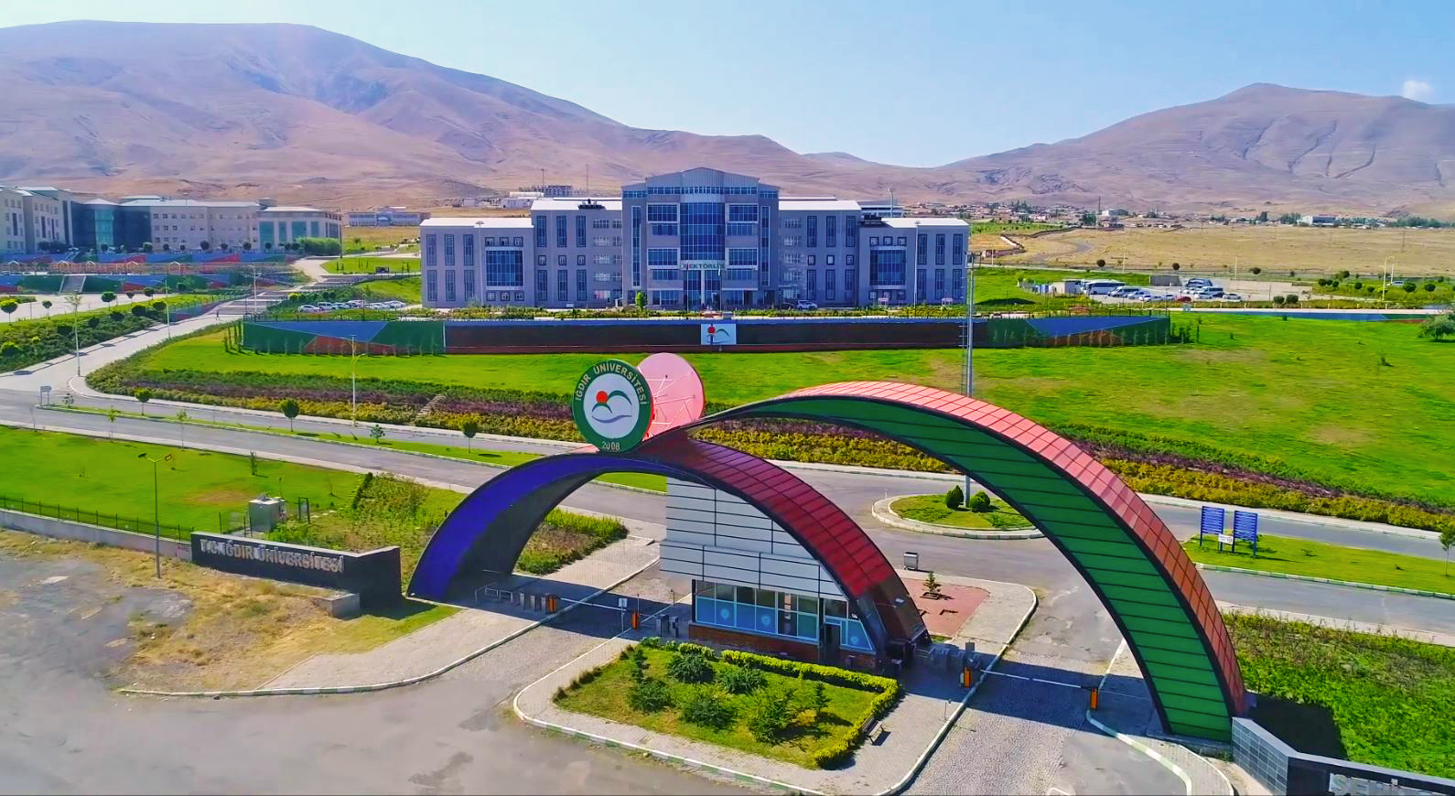
Iğdır University Faculty of Applied Sciences, Public Relations and Advertising Department received its first students in the 2019-2020 academic year.

Slide 3
The education period of the Department of Public Relations and Advertising, whose education language is Turkish, is 4 years.
The department, which provides education at the undergraduate level, accepts students according to the Higher Education Institutions Examination (YKS), TYT exam score and Verbal score type.

Slide 4
Igdır University, Faculty of Applied Sciences, Department of Public Relations and Advertising,
It aims to train students who have a good grasp of the concepts and theories of communication, promotion, advertising, marketing, public relations, who can use new communication technologies strategically, and who have the ability to put their knowledge into practice with all kinds of communication studies in the business world, by providing an up-to-date education based on the basic principles of communication.

Slide 5
Graduates of Public Relations and Advertising Department both in the public and private sectors;
They can work with titles such as
Communication Specialist,
Advertising and Public Relations Officer,
Corporate Communications Officer, Brand Manager,
Marketing Communication Coordinator.
Also,
They can work in departments such as
Digital Advertising Agencies,
Promotion,
Advertising and Marketing Companies,
Political Parties,
Brand Consulting Companies,
Corporate Communications,
Digital Marketing,
Human Resources.

